Slide 1
Research & Summarising Is there an Environmental Kuznets Curve for CO2 emissions? A time series analysis on the US
MADE BY :
ASHUTOSH SINGH
2K20/EE/067
DELHI TECHNOLOGICAL UNIVERSITY

Slide 2
ABSTRACT
This paper examines the relationship between CO2 emissions and income in the US. Using a time-series approach for the period 1971-2010, the quadratic Environmental Kuznets Curve (EKC) hypothesis is tested against alternative specifications of the emissions-income relationship. To account for potential omitted variable bias, four additional determinants of CO2 emissions are included in the estimation. The findings lead to the rejection of the quadratic EKC in the case of the US in favour of a cubic emissions-income relationship. In particular, the existence of an inverted Nshaped relationship is corroborated in this study, with the key implication that economic growth appears to be a solution to the problem of CO2 emissions in the US.

Slide 3
Introduction
Climate change is unequivocal. It is the most pressing environmental issue facing the world today and is proving difficult to resolve. Indeed, Stern (2007) describes it as “the greatest and widestranging market failure ever seen” for which urgent international cooperation is required to effectively mitigate the problem. Overwhelming scientific evidence now point to carbon dioxide (CO2 ) emissions as the main driver of global warming. Despite international efforts such as the Kyoto Protocol in setting out explicit CO2 emissions targets, global emissions are still rising. The fact remains that there needs to be a clearer understanding of what is contributing to emissions before nations can even begin tackling the problem, hence the rationale for this study

Slide 4
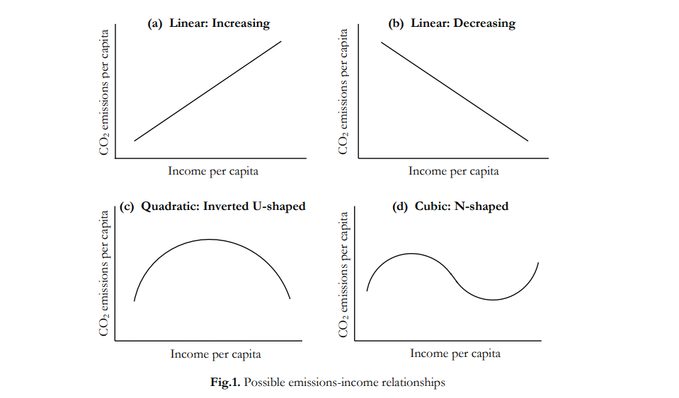

Slide 5
Recent literature has explored the link between CO2 emissions and income, with a particular focus on the Environmental Kuznets Curve (EKC) hypothesis. This is an inverted U-shaped (Fig.1c) relationship between CO2 emissions per capita and income per capita, analogous to the conventional Kuznets Curve (1955) relationship between inequality and income per capita.1 Hence, the EKC conjectures that whilst CO2 emissions pc intensifies initially with income pc, it eventually reaches a turning point and subsides in the later stages. This ‘later’ stage is often referred to as a decoupling of CO2 emissions from economic growth, and suggests that beyond a certain income threshold, economic growth may actually “become a solution rather than a source of the problem [of CO2 1 Per capita will be abbreviated to pc hereafter Income per capita CO2 emissions per capita (c) Quadratic: Inverted U-shaped Income per capita CO2 emissions per capita (b) Linear: Decreasing Income per capita CO2 emissions per capita (d) Cubic: N-shaped Income per capita CO2 emissions per capita (a) Linear: Increasing Fig.1. Possible emissions-income relationships EC902 Econometrics A Project Candidate No: 3 emissions]” (Soytas et al., 2007). This decoupling phenomenon is possible if there is greater demand for environmental quality at higher pc income levels, which induces pollution abatement efforts. In addition to the quadratic EKC relationship between CO2 emissions pc and income pc, linear (Fig.1a and 1b) and cubic N-shaped (Fig.1d) relationships have also been posited in the literature. Holtz-Eakin & Selden (1995) note the free-rider problem associated with CO2 emissions, which makes an increasing linear relationship more likely. This is because contrary to other air pollutants such as sulphur dioxide (SO2 ), CO2 has global rather than local effects. Consequently, no individual country has an incentive to abate CO2 emissions, thus diluting the tendency for CO2 emissions pc to fall at higher income pc levels. Likewise, an N-shaped cubic relationship is possible if the upward tail that follows the initial inverted U-shaped curve is indicative of abatement efforts being exhausted (De Bruyn et al, 1998).

Slide 6
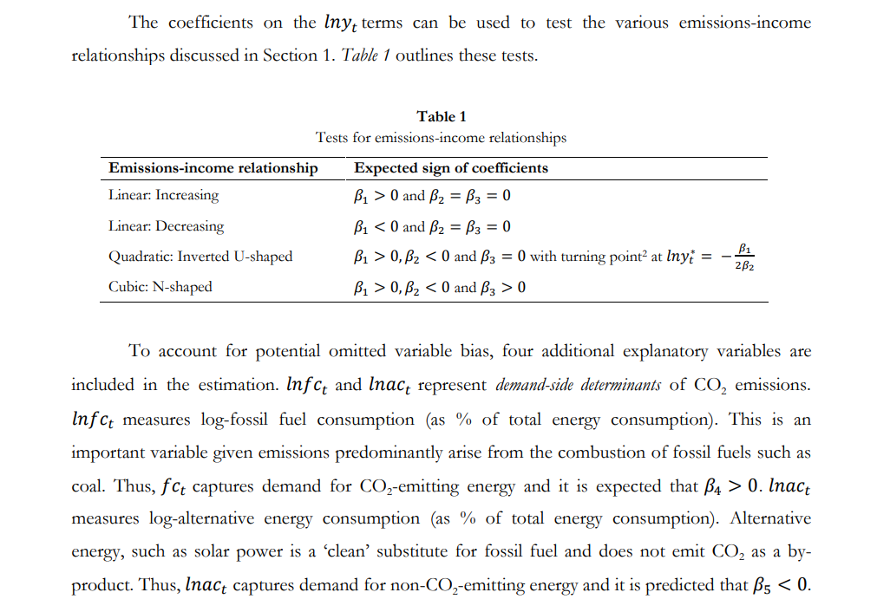

Slide 7
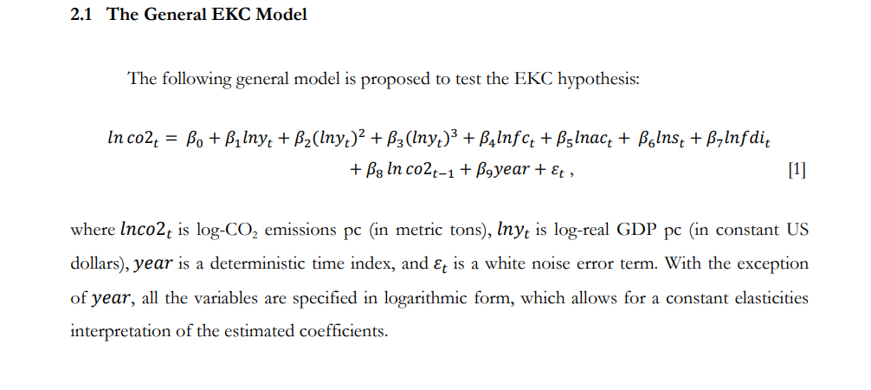
Empirical Model & Methodology

Slide 8
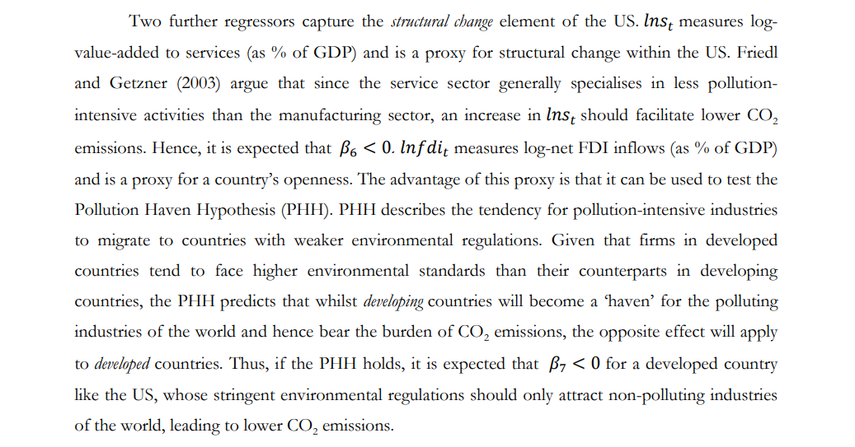

Slide 9
The Data
The annual time-series dataset covering 1971-2010 is attained from the World Bank’s online database, giving way to 40 observations in total. Collecting from a single, reliable source (as opposed to multiple sources) has the advantage of ensuring consistency in the way variables are defined and measured, thus minimising measurement bias in the estimation. However, better quality data is at the expense of a restricted dataset. For example, no data is available for fossil fuel consumption and alternative energy consumption prior to 1971, and as such imposes a lower bound on the sample range. Another weakness of the data is the small number of observations3 , which may undermine the precision with which the population parameters are estimated.

Slide 10
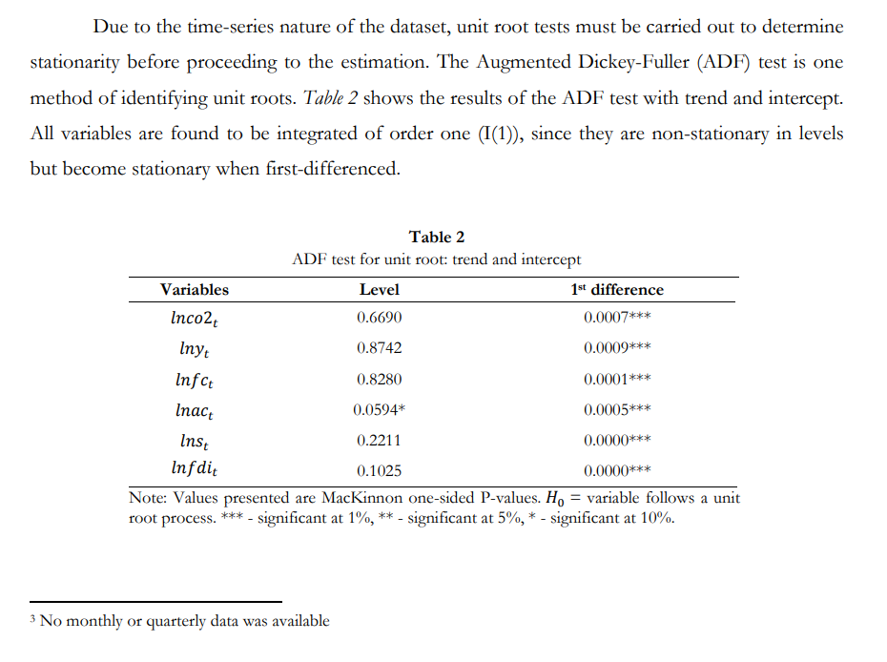
Stationarity

Slide 11
Cointegration
Given that all variables are I(1), a levels-on-levels regression of the General EKC Model may be spurious, in that a significant relationship is detected between a set of independent nonstationary series just because they are all trending over time. According to Granger and Newbold (1974), a spurious regression is characterised by a high R2 -value together with significant positive autocorrelation in the residuals. In the case of a spurious regression, the estimated OLS coefficients will be inconsistent and the usual t-stats will be misleading. However, if the I(1) variables in the regression are cointegrated, in that a linear combination of them is I(0), then the OLS regression will not be spurious and the usual t-stats and interpretations apply. The Engle-Granger (1987) test is used to detect cointegration between a set of I(1) variables. This is an application of the ADF test to the residuals of the General EKC Model estimation. Cointegration is present if the null hypothesis of a unit root in the residuals is rejected, i.e. if the residuals are I(0). If this is the case, then the claim of spurious regression can be ignored and the usual OLS estimates and interpretations hold for the General EKC Model.

Slide 12
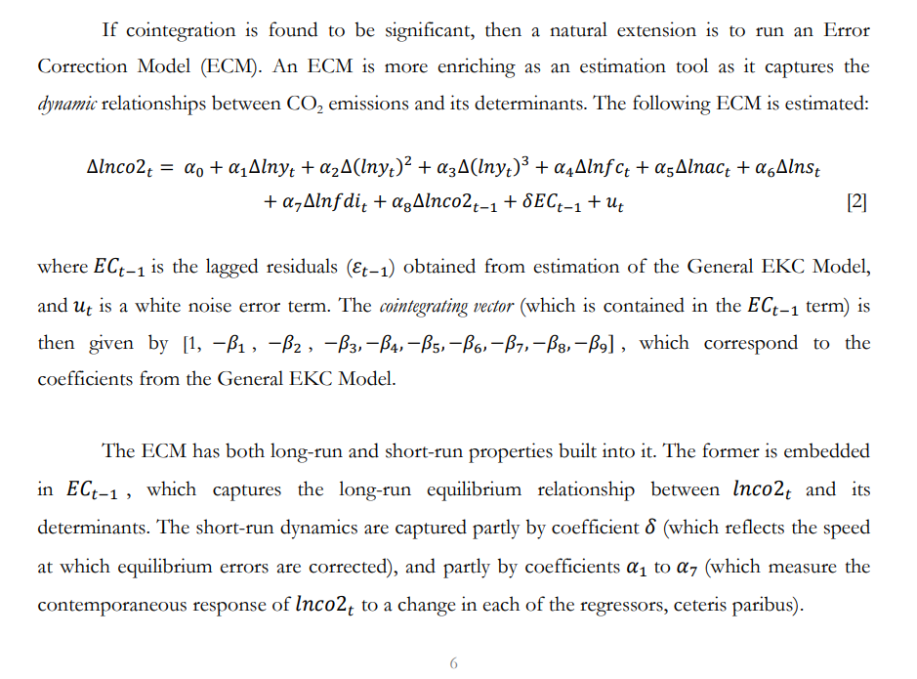
The Error Correction Model

Slide 13
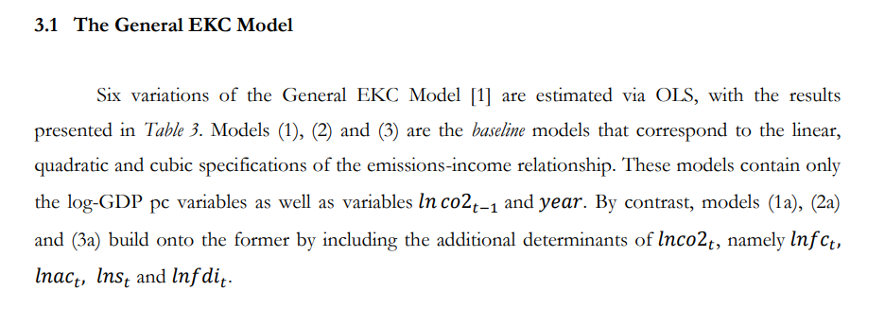
Model Estimation and Results

Slide 14
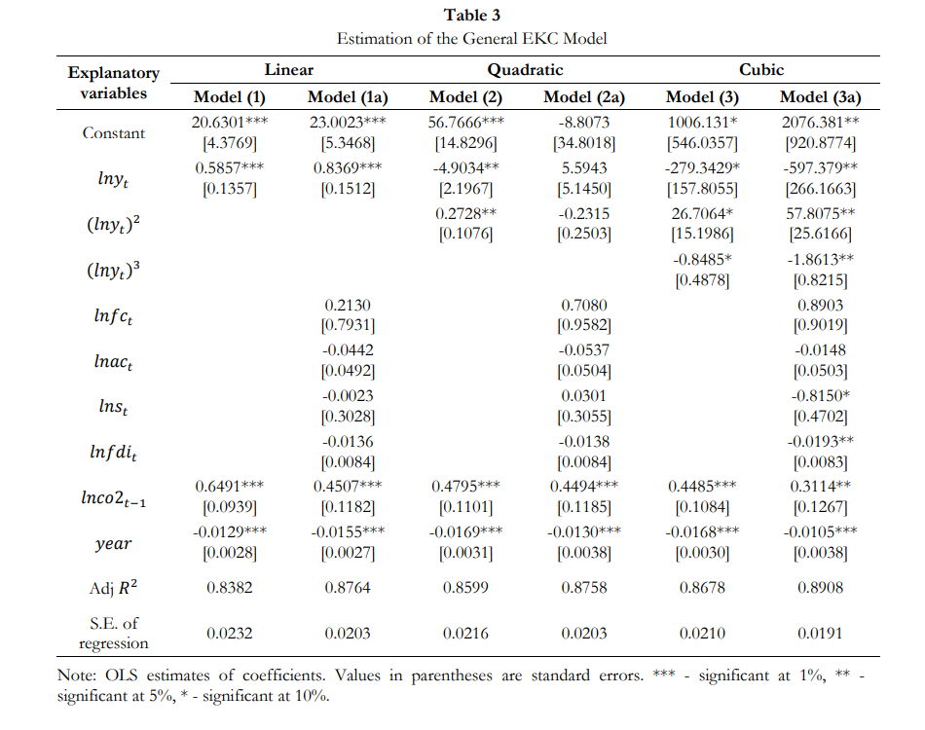

Slide 15
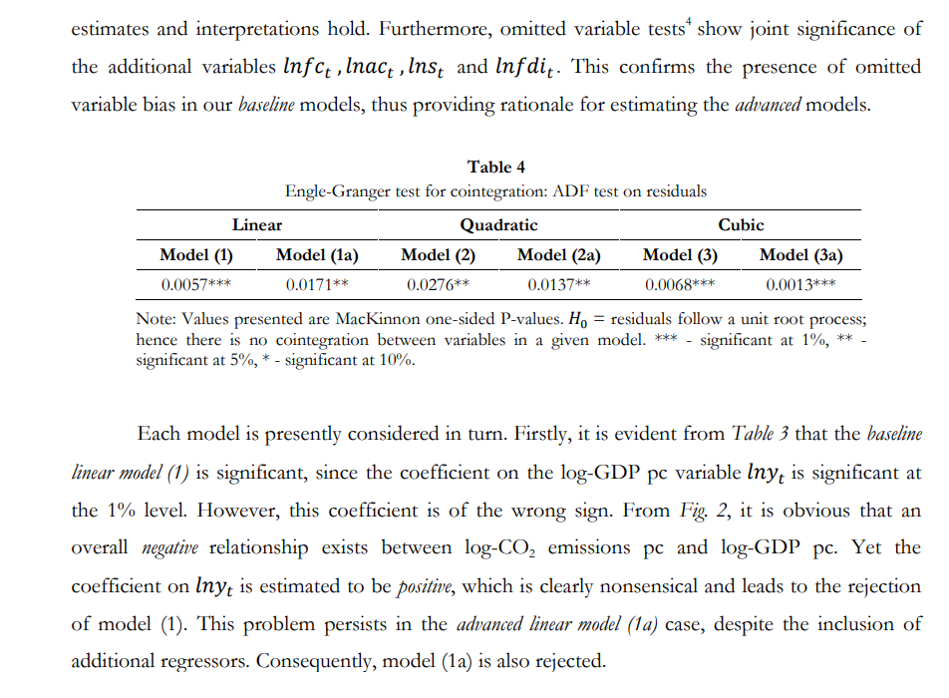

Slide 16
Although the baseline quadratic model (2) is significant at the 5% level (given significant coefficients on the log-GDP pc variables), it does not support the hypothesis of an inverted U-shaped EKC. This is because the coefficients on and ( ) have the opposite signs to those predicted by the EKC, even though both are statistically different from zero. By contrast, inclusion of additional regressors in the advanced quadratic model (2a) elicits quite the opposite problem. Whilst the signs of the log-GDP pc coefficients are consistent with the EKC, the coefficients are now both statistically insignificant. In fact, none of the regressors in model (2a) have any significant explanatory power, except for and . Clearly, the EKC hypothesis is unfounded under both versions of the quadratic model ((2) and (2a)), and consequently they are rejected. In the cubic case, the baseline model (3) and its advanced counterpart (3a) have the same qualitative predictions regarding the emissions-income relationship. However, the latter is more significant, with coefficients on the log-GDP pc variables significant at the 5% level, as opposed to 10%. Model (3) is therefore rejected in light of a better advanced model (3a). Interestingly, model (3a) yields coefficients on ( ) and ( ) that appear to go against the hypothesis of an N-shaped emissions-income relationship, where and . Instead, the coefficients corroborate an inverted N-shaped relationship, where the signs are reversed (Friedl and Getzner, 2003). This is apparent in Fig. 2, in which an initial U-shaped emissions-income relationship is followed by a downward tail, yielding an inverted N-shape overall. Intuitively, it could be that logCO2 emissions pc is at first falling due to domestic abatement measures, reaching a trough at a logGDP pc level of $10.2. Beyond this income threshold, emissions start to rise as a result of domestic abatement efforts being exhausted, hence the initial U-shape. The downward tail beyond log-GDP pc of $10.6 can be explained if the US resolves its domestic abatement limitations by outsourcing pollution-intensive production to other countries, thereby reducing its own emissions. Model (3a) will be the Preferred Model for the US hereafter

Slide 17
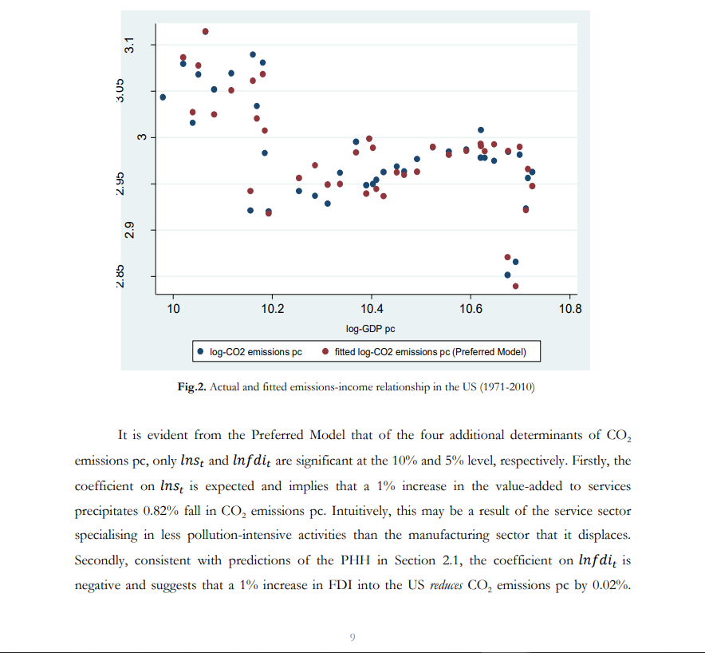

Slide 18
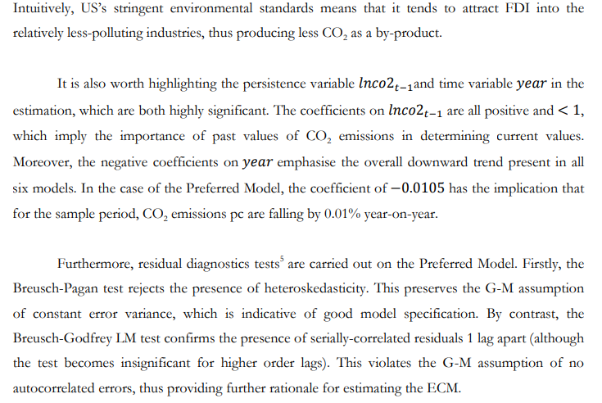

Slide 19
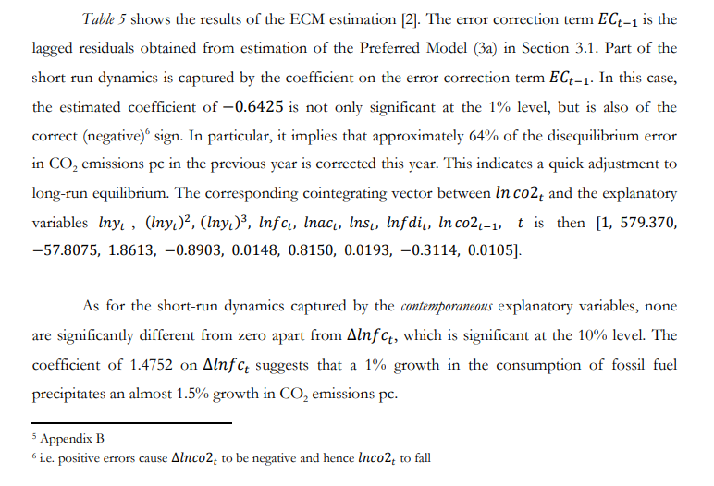
The ECM

Slide 20
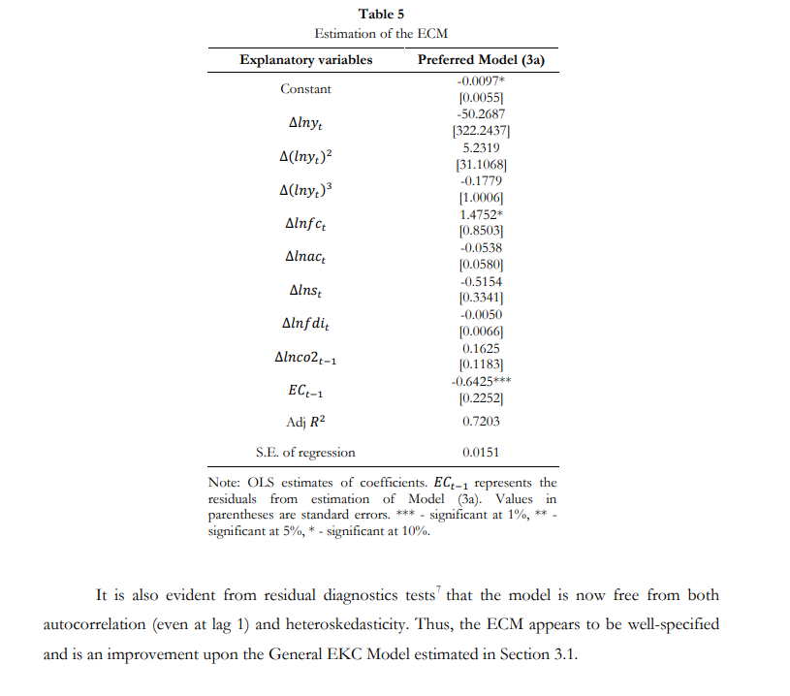

Slide 21
CONCLUSION
The objective of this paper was to test empirically the CO2 EKC for the US. Using annual time series data for 1971-2010, the quadratic inverted U-shaped EKC was tested against the alternative linear and cubic specifications of the emissions-income relationship. Given the presence of omitted variable bias, four additional explanatory variables were included in the estimation. The results led to the rejection of the quadratic EKC in the case of the US. Instead, the advanced cubic model (3a) was found to be the most appropriate in terms of econometric quality, corroborating the existence of an inverted N-shaped emissions-income relationship. This supports the decoupling phenomenon mentioned in Section 1, with the implication that economic growth appears to be a solution to the problem of CO2 emissions. Not only do our findings undermine US’s claim that cutting CO2 emissions is growth-reducing, but they also imply that the country should join the Kyoto Protocol given that economic growth and emissions reduction go hand-in-hand. In addition to the effect of income on emissions, the results also suggest that the US could achieve lower CO2 emissions by increasing FDI inflows (Table 3).8 Alternatively, the country could lower CO2 emissions by increasing the relative size of its service sector. From the ECM estimation, it is moreover found that the country could put a brake on emissions growth by implementing policies aimed at reducing the rate of fossil fuel consumption (Table 5), for example by imposing a higher fuel duty.

Slide 22
Caveats and Extensions
It is worth highlighting some limitations of the study that merit consideration in subsequent research. First is the issue of using aggregate data. Seeing as the US is a large country, it would be naive to assume that inter-state variations in the emissions-income relationship do not exist. As evidenced by Aldy (2005) in his study, different states follow different emissions-income paths. It would therefore be useful in future EKC studies to account for these inherent inter-state differences. Secondly, the results of this paper are unique to the US, and as such cannot be generalised to other countries. A natural extension would be to carry out a panel study of the EKC hypothesis on both developed and developing countries. Lastly, the findings are not robust to the sample period. Had a different sample period been chosen, alternative implications may have been drawn. Despite these limitations, this paper has all-in-all provided a statistically-robust analysis of the CO2 EKC on the US, with the conclusion that the EKC was rejected.

Slide 23
REFERENCES
Aldy, J.E. (2005). An environmental Kuznets curve analysis of U.S. state-level carbon dioxide emissions. Environment and Development Economics, Vol. 14, pp. 48-72.
De Bruyn, S.M., van den Bergh, J.C.J.M. and Opschoor, J.B. (1998). Economic growth and emissions: reconsidering the empirical basis of the Environmental Kuznets Curves. Ecological Economics, Vol. 25 (2), pp. 161-175.
Friedl, B. and Getzner, M. (2003). Determinants of CO2 emissions in a small open economy. Ecological Economics, Vol. 45, pp. 133-148.
Granger, C.W.J. and Newbold, P. (1973). Spurious regressions in econometrics. Journal of Econometrics, Vol. 2, pp. 111-120.
Holtz-Eakin, D. and Selden, T.M. (1995). Stoking the fires? CO2 emissions and economic growth. Journal of Public Economics, Vol. 57, pp. 85-101.
Kuznets, S. (1955). Economic Growth and Income Inequality. The American Economic Review, Vol. 45, No. 1 (Mar., 1955), pp. 1-28. Soytas, U., Sari, R. and Ewing, B.T. (2007).
Energy consumption, income, and carbon emissions in the United States. Ecological Economics, Vol. 62, Issue 3-4, pp. 482-489. Stern, N. (2007).
The Economics of Climate Change: The Stern Review. Cambridge and New York: Cambridge University Press.

